Slide 1
Development Approach
SE423: Software Project Management

Slide 2
Outline
Methodology Concepts
Software Development Process
Agile Project Management
DevOps

Slide 3
Methodology Concepts

Slide 4
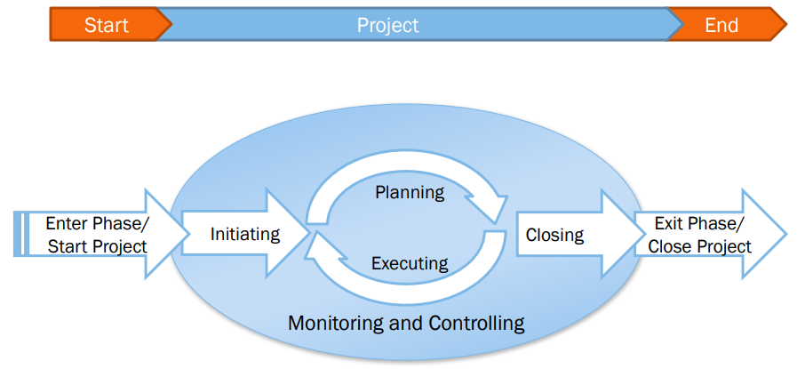
Project Life Cycle

Slide 5
Methodology Concepts
Process
A collection of work activities, actions and tasks that are performed when some work product is to be created
Process Model or Life Cycle
An abstract description of a software process that presents one view of that process
Waterfall, Iterative, Spiral, Evolutionary, etc.
Process Methodology or Methodology
Instantiations of process models – tend to be prescriptive.
The conventions that a group agrees to – “How we work around here”

Slide 6
What a Methodology Addresses?
Introducing new people to the process
Substituting people
Delineating responsibilities
Demonstrating visible progress
McConnell’s definition for visibility: “The ease & accuracy with which it is possible to assess the status of a project’s cost, schedule, functionality, or other characteristic.”

Slide 7
Evaluating a Methodology
How rapidly you can substitute or train people.
How great an effect it has on the sales process.
How much freedom (or how constraining) it is to people on the project.
How fast it allows people to respond to changing situations.
How well it “protects” the organization – legally or from other damages.

Slide 8
Elements of a Methodology
Teams
Roles
Skills
Techniques
Activities
Process
Work Products
Milestones
Standards
Quality

Slide 9
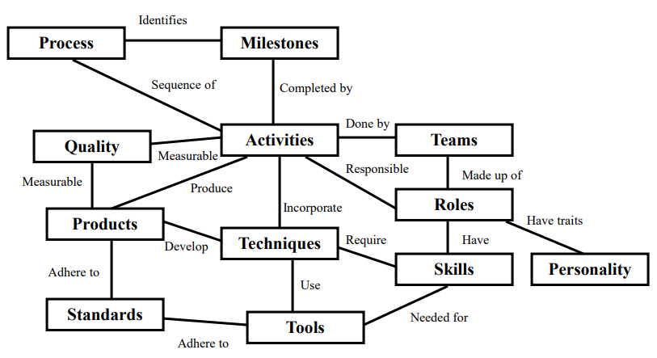
Cockburn Methodology Structure

Slide 10
Elements of a Methodology
Activities
the meetings, reviews, and other general activities the person must attend, generate or do.
Process
the sequencing of activities over time with pre and post conditions for the activities.
Milestones
events marking progress or completion. Milestones mark an instant in time and are either fully met or not met.

Slide 11
Elements of a Methodology
Teams
how you group the people and how you assign people to roles.
Roles
the job descriptions of team members: project manager, requirements gatherer, tester, program designer, etc. Roles may need to consider the personalities of the people being assigned to those roles.
Skills
the skills team members should have in order to assume responsibility for their role on the project.

Slide 12
Elements of a Methodology
Products
what each person or team hands to another person or team: use cases, class designs, test specifications, framework documentation, interface definitions, etc.
Techniques
the techniques the person uses in their work: requirement session facilitation, Java programming, use case modeling, etc.
Tools
what tools the people use in their jobs, either within a technique or to produce a deliverable according to the standard.

Slide 13
Elements of a Methodology
Standards
what is permitted or not permitted in the work product. There are notational standards (which includes the programming language), management and decision standards, and project conventions. The methodology may leave certain standards open, to be determined on the project.
Quality
what rules, issues or concerns are to be tracked for each deliverable or activity.

Slide 14
IT project life cycles
IT projects have two concurrent life cycles:
Project life cycle (PLC) encompasses all activities of project, including the System/Software Development Life Cycle (SDLC)
PLC is directed toward achieving project requirements
SDLC is directed toward achieving product requirements
Both life cycle models are needed to manage an IT project
PLC alone will not adequately address system development concerns
SDLC alone will not adequately address business and product integration concerns
Effective integration of the two life cycle models is essential to improving the likelihood of project success

Slide 15
Software Development Process

Slide 16
Software Development Process
Ad hoc
Code and Fix
Rapid Prototyping
Prescriptive
Linear/sequential (Classic and Waterfall)
Evolutionary (Iterative/incremental or spiral)
Unified Process
Adaptive
Lean and agile methods
Notes:
SE 425
April 3, 2008
Lecture 1
16/85
SE 425
April 3, 2008
Lecture 1
16/108
Lecture 1
January 8, 2008
SE 425
16/108

Slide 17
Plan-driven Methodology
The “traditional” way to develop software
Based on system engineering and quality disciplines (process improvement)
Standards developed from DoD & industry to make process fit a systems approach
Values well defined work products

Slide 18
Plan-driven Characteristics
Focus on repeatability and predictability
Defined, standardized, and incrementally improving processes
Thorough documentation
A software system architecture defined up-front
Detailed plans, workflow, roles, responsibilities, and work product descriptions
Process group containing resources for specialists: process monitoring, controlling, and educating
On-going risk management
Focus on verification and validation

Slide 19
Sequential (‘waterfall’) methodology
The term waterfall was coined by Winston Royce in a 1970 paper titled Managing the Development of Large Software Systems, in the Proceedings of IEEE WESCON
The paper used the sequential waterfall approach as an example of an ill-conceived, risk-prone practice for developing large systems
Royce advocated a series of iterative feedback loops among the development stages, incrementally gaining learning value from working software
Instead of adopting the approach Royce advocated, managers and practitioners adopted its anti-form, without feedback loops

Slide 20
Waterfall SDLC
Each phase is marked by completion of Deliverables
The primary software project phases:
Requirements
Analysis
Design
Construction
Quality Assurance (aka Testing)
Deployment

Slide 21
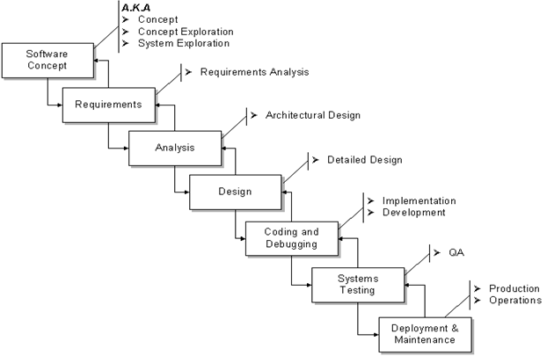
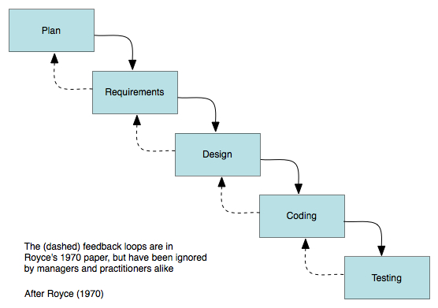
Waterfall SDLC

Slide 22
Waterfall system development model
Highly-sequential process
Failure symptoms:
Protracted integration and late design breakage
Late risk resolution
Requirements-driven functional decomposition
Adversarial stakeholder relationships
Focus on documents and review meetings
Still followed (in name or practice) by many organizations, usually a modified version

Slide 23
Waterfall system development model
Sequential: suitable projects and management approaches
A sequential SDLC is suitable for projects with:
Clear, unambiguous, and stable user requirements
Familiar, proven technology
Low complexity
Adequate time
Stable schedule
A project meeting most of these criteria can use conventional project management practices, such a big, up-front planning and conventional risk assessment

Slide 24
Evolutionary methodologies
An evolutionary methodology follows an iterative and incremental approach that allows the start of development with incomplete, imperfect knowledge
An iterative and incremental process is like solving a jigsaw puzzle: neither top-down nor bottom-up but accretionary and convergent
An iterative and incremental process offers these advantages:
Logical progress toward evolving a robust architecture
Effective management of changing requirements
Effective means to address changes in planning
Ability to perform continuous integration
Early understanding of the system (the ‘Hello world!’ effect)
Ongoing risk assessment
Evolutionary methodologies are incremental at both the macro (project- scale) and micro (working team) process levels

Slide 25
Iterative system development model
Non-linear approach to system development
Incorporates top five principles of modern development processes:
Architecture first. Provides the central design element
Iterative life-cycle process. Provides the essential risk management element
Component-based development. Provides the technology element
Change management environment. Provides the control element
Round-trip engineering. Provides the automation element

Slide 26
5,000 foot view of Iterative SDLC
Iterative SD model defines four life-cycle phases:
Inception
Elaboration
Construction
Transition
We iterate through each phase, and repeat as needed.
Now, for a quick survey of the phases…

Slide 27
Inception phase
Essential activities
Formulate product scope. Capture requirements and operational concept
Perform feasibility analysis. Determine whether the organization has the resources and technical capabilities to meet customer's needs
Synthesize the system architecture. Evaluate essential system design constraints and trade-offs, as well as available solutions
Plan and prepare business case. Address risk management, staffing, iteration plans, cost, and infrastructure

Slide 28
Elaboration phase
Most critical phase of the four
Essential activities
Elaborate the vision. Detail elements of the vision that drive architectural or planning decisions
Elaborate the process and infrastructure. The construction process and environment are established here
Elaborate the architecture and select reusable (internal or COTS) components. Baseline the architecture as quickly as possible and demonstrate that the architecture will support the vision at reasonable cost in reasonable time

Slide 29
Construction phase
Essential activities
Achieve useful versions (intermediate, alpha, beta, and other test releases)
Perform resource management, control, and process optimization
Complete component development and test
Assess product releases against acceptance criteria

Slide 30
Transition phase
Essential activities
Perform deployment-specific engineering tasks. Commercial packaging and production, sales kit development, field personnel training
Assess deployment baselines against complete vision and acceptance criteria. Examine and compare what is being delivered to what was envisioned and delineated by acceptance criteria
Plan for next iteration

Slide 31
Comparative expenditure profiles
Waterfall |  | Iterative
Activity | Cost | Cost | Activity
Management | 5% | 10% | Management
Requirements | 5% | 10% | Requirements
Design | 10% | 15% | Design
Code & Unit Testing | 30% | 25% | Implementation
Integration & Test | 40% | 25% | Assessment
Deployment | 5% | 5% | Deployment
Environment | 5% | 10% | Environment
Total | 100% | 100% | Total

Slide 32
Suitable Projects And Management Approaches
An evolutionary SDLC is suitable for projects with:
Reasonably–but not perfectly–clear user requirements
Unfamiliar or unproven technology
High complexity
Short time schedule
Schedule variability
Such a project would use rolling wave planning rather than big, up-front planning and use a continuous, adaptive approach to risk assessment and management

Slide 33
Agile Project Management

Slide 34
Agile software engineering
Software products must be brought to market quickly so rapid software development and delivery is essential.
Virtually all software products are now developed using an agile approach.
Agile software engineering focuses on delivering functionality quickly, responding to changing product specifications and minimizing development overheads.

Slide 35
Agile Manifesto Values, Principles, and Common Practices
Agile Mindset
4
Values
12
Principles
Practices

Slide 36
Agile is a Blanket Term for Many Approaches
Lean
Agile
Kanban
ScrumBan
Crystal
Scrum
AUP
XP
FDD
DSDM

Slide 37
Agile is a mindset defined by 4 values, guided by 12 principles, and manifested through many different practices. Agile practitioners select practices based on their needs.
Agile Manifesto and Mindset

Slide 38
The Four Values of the Agile Manifesto (Manifesto for Agile Software Development, 2001)
We are uncovering better ways of developing software by doing it and helping others do it. Through this work we have come to value:
individuals and interactions over processes and tools
working software over comprehensive documentation
customer collaboration over contract negotiation
responding to change over following a plan
That is, while there is value in the items on the right, we value the items on the left more.

Slide 39
The Twelve Principles Behind the Agile Manifesto
1. Our highest priority is to satisfy the customer through early and continuous delivery of valuable software.
2. Welcome changing requirements, even late in development. Agile processes harness change for the customer’s competitive advantage.
3. Deliver working software frequently, from a couple of weeks to a couple of months, with a preference to the shorter timescale.
4. Business people and developers must work together daily throughout the project.
5. Build projects around motivated individuals. Give them the environment and support they need, and trust them to get the job done.
6. The most efficient and effective method of conveying information to and within a development team is face-to-face conversation.

Slide 40
The Twelve Principles Behind the Agile Manifesto
7. Working software is the primary measure of progress.
8. Agile processes promote sustainable development. The sponsors, developers, and users should be able to maintain a constant pace indefinitely.
9. Continuous attention to technical excellence and good design enhances agility.
10. Simplicity—the art of maximizing the amount of work not done—is essential.
11. The best architectures, requirements, and designs emerge from self-organizing teams.
12. At regular intervals, the team reflects on how to become more effective, then tunes and adjusts its behavior accordingly.

Slide 41
Agile Development Principles
Involve the customer Involve customers closely with the software development team. Their role is to provide and prioritize new system requirements and to evaluate each increment of the system.
Embrace change Expect the features of the product and the details of these features to change as the development team and the product manager learn more about it. Adapt the software to cope with changes as they are made.
Develop and deliver incrementally Always develop software products in increments. Test and evaluate each increment as it is developed and feed back required changes to the development team.

Slide 42
Agile Development Principles
Maintain simplicity Focus on simplicity in both the software being developed and in the development process. Wherever possible, do what you can to eliminate complexity from the system.
Focus on people, not things Trust the development team and do not expect everyone to always do the development process in the same way. Team members should be left to develop their own ways of working without being limited by prescriptive software processes.

Slide 43
Agile software engineering
A large number of ‘agile methods’ have been developed.
There is no ‘best’ agile method or technique.
It depends on who is using the technique, the development team and the type of product being developed

Slide 44
Agile methods
Plan-driven development evolved to support the engineering of large, long-lifetime systems
This approach is based on controlled and rigorous software development processes that include detailed project planning, requirements specification and analysis and system modelling.
However, plan-driven development involves significant overheads and documentation and it does not support the rapid development and delivery of software.
Agile methods were developed in the 1990s to address this problem.
These methods focus on the software rather than its documentation, develop software in a series of increments and aim to reduce process bureaucracy as much as possible.

Slide 45
Incremental development
All agile methods are based around incremental development and delivery.
Product development focuses on the software features, where a feature does something for the software user.
With incremental development, you start by prioritizing the features so that the most important features are implemented first.
You only define the details of the feature being implemented in an increment.
That feature is then implemented and delivered.
Users or surrogate users can try it out and provide feedback to the development team. You then go on to define and implement the next feature of the system.

Slide 46
Incremental development
1
Product feature list
Choose features to be included in increment
If all features are complete, deliver system release
5
2
Deliver system increment
Refine features descriptions
4
3
Integrate feature into system
Implement and test feature

Slide 47
Incremental development activities
Choose features to be included in an increment Using the list of features in the planned product, select those features that can be implemented in the next product increment.
Refine feature descriptions Add detail to the feature descriptions so that the team have a common understanding of each feature and there is sufficient detail to begin implementation.
Implement and test Implement the feature and develop automated tests for that feature that show that its behaviour is consistent with its description.
Integrate feature and test Integrate the developed feature with the existing system and test it to check that it works in conjunction with other features.
Deliver system increment Deliver the system increment to the customer or product manager for checking and comments. If enough features have been implemented, release a version of the system for customer use.

Slide 48
Extreme programming
The most influential work that has changed software development culture was the development of Extreme Programming (XP).
The name was coined by Kent Beck in 1998 because the approach was developed by pushing recognized good practice, such as iterative development, to ‘extreme’ levels.
Extreme programming focused on 12 new development techniques that were geared to rapid, incremental software development, change and delivery.
Some of these techniques are now widely used; others have been less popular.

Slide 49
Extreme Programming Practices
Test-first development
Continuous integration
Refactoring
Incremental planning
Small releases
Extreme Programming (XP)
Collective ownership
Simple design
Pair programming
On-site customer
Sustainable pace

Slide 50
Widely adopted XP practices
Incremental planning/user stories
There is no ‘grand plan’ for the system. Instead, what needs to be implemented (the requirements) in each increment are established in discussions with a customer representative.
The requirements are written as user stories.
The stories to be included in a release are determined by the time available and their relative priority.

Slide 51
Widely adopted XP practices
Small releases
The minimal useful set of functionality that provides business value is developed first.
Releases of the system are frequent and incrementally add functionality to the previous release.

Slide 52
Widely adopted XP practices
Test-driven development
Instead of writing code then tests for that code, developers write the tests first.
This helps clarify what the code should actually do and that there is always a ‘tested’ version of the code available.
An automated unit test framework is used to run the tests after every change.
New code should not ‘break’ code that has already been implemented.

Slide 53
Widely adopted XP practices
Continuous integration
As soon as the work on a task is complete, it is integrated into the whole system and a new version of the system is created.
All unit tests from all developers are run automatically and must be successful before the new version of the system is accepted.

Slide 54
Widely adopted XP practices
Refactoring
Refactoring means improving the structure, readability, efficiency and security of a program.
All developers are expected to refactor the code as soon as potential code improvements are found.
This keeps the code simple and maintainable.

Slide 55
Widely adopted XP practices
Incremental planning/user stories
There is no ‘grand plan’ for the system. Instead, what needs to be implemented (the requirements) in each increment are established in discussions with a customer representative.
The requirements are written as user stories.
The stories to be included in a release are determined by the time available and their relative priority.

Slide 56
Scrum
Software company managers need information that will help them understand how much it costs to develop a software product, how long it will take and when the product can be brought to market.
Plan-driven development provides this information through long-term development plans that identify deliverables - items the team will deliver and when these will be delivered.
Plans always change so anything apart from short-term plans are unreliable.
Scrum is an agile method that provides a framework for agile project organization and planning. It does not mandate any specific technical practices.

Slide 57
Scrum Terminology
Scrum A daily team meeting where progress is reviewed and work to be done that day as discussed and agreed.
Sprint A short period, typically two to four weeks, when a product increment is developed.
ScrumMaster A team coach who guides the team in the effective use of Scrum.

Slide 58
Scrum Terminology
Product The software product that is being developed by the Scrum team.
Product owner A team member who is responsible for identifying product features and attributes. They review work done and help to test the product.
Product backlog A to-do list of items such as bugs, features and product improvements that the Scrum team have not yet completed.

Slide 59
Scrum Terminology
Development team A small self-organising team of five to eight people who are responsible for developing the product.
Potentially shippable product increment The output of a sprint which should be of high enough quality to be deployed for customer use.
Velocity An estimate of how much work a team can do in a single sprint.

Slide 60
Key roles in Scrum
The Product Owner is responsible for ensuring that the development team are always focused on the product they are building rather than diverted into technically interesting but less relevant work.
In product development, the product manager should normally take on the Product Owner role.
The ScrumMaster is a Scrum expert whose job is to guide the team in the effective use of the Scrum method. The developers of Scrum emphasize that the ScrumMaster is not a conventional project manager but is a coach for the team. They have authority within the team on how Scrum is used.
In many companies that use Scrum, the ScrumMaster also has some project management responsibilities.

Slide 61
Scrum and sprints
In Scrum, software is developed in sprints, which are fixed-length periods (2 - 4 weeks) in which software features are developed and delivered.
During a sprint, the team has daily meetings (Scrums) to review progress and to update the list of work items that are incomplete.
Sprints should produce a ‘shippable product increment’. This means that the developed software should be complete and ready to deploy.

Slide 62
Scrum cycles
Start
1
Review product backlog
Select items to implement
Review sprint
Product backlog
Plan sprint
Shippable product increment
sprint
Test software
Sprint backlog
Scrum
Develop software

Slide 63
Key Scrum practices
Product backlog This is a to-do list of items to be implemented that is reviewed and updated before each sprint.
Timeboxed sprints Fixed-time (2-4 week) periods in which items from the product backlog are implemented,
Self-organizing teams Self-organizing teams make their own decisions and work by discussing issues and making decisions by consensus.

Slide 64
Product backlogs
The product backlog is a list of what needs to be done to complete the development of the product.
The items on this list are called product backlog items (PBIs).
The product backlog may include a variety of different items such as product features to be implemented, user requests, essential development activities and desirable engineering improvements.
The product backlog should always be prioritized so that the items that be implemented first are at the top of the list.

Slide 65
Examples of Product Backlog Items (PBIs)
1. As a teacher, I want to be able to configure the group of tools that are available to individual classes. (feature)
2. As a parent, I want to be able to view my children’s work and the assessments made by their teachers. (feature)
3. As a teacher of young children, I want a pictorial interface for children with limited reading ability. (user request)
4. Establish criteria for the assessment of open source software that might be used as a basis for parts of this system. (development activity)
5. Refactor user interface code to improve understandability and performance. (engineering improvement)
6. Implement encryption for all personal user data. (engineering improvement)

Slide 66
Product backlog item states
Ready for consideration These are high-level ideas and feature descriptions that will be considered for inclusion in the product. They are tentative so may radically change or may not be included in the final product.
Ready for refinement The team has agreed that this is an important item that should be implemented as part of the current development. There is a reasonably clear definition of what is required. However, work is needed to understand and refine the item.
Ready for implementation The PBI has enough detail for the team to estimate the effort involved and to implement the item. Dependencies on other items have been identified.

Slide 67
Product backlog activities
REVISED
PRODUCT BACKLOG
PRODUCT BACKLOG
Refinement
PBI 1.1
PBI 1
PBI 1.2
PBI 2
Estimation
PBI 2E
PBI 3
PBI 3E
PBI 4
Prioritization
PBI 4
PBI 5
PBI 5
Creation
PBI 6

Slide 68
Sprint activities
Sprint
planning
Sprint backlog
Sprint review
Sprint execution
Sprint backlog
Integration
Scrum
Develop software

Slide 69
Managing External Interactions
External interactions
Team-focused external interactions
Product-focused external interactions
ScrumMaster
Product owner

Slide 70
Project Management Responsibilities
Budget
Schedule
Risks
Problems
Progress
Reporting
Project Management
Administration
People
Finance
Compliance
Procurement
Liaison
Vacations Absence Work quality Reviewing
Hiring

Slide 71
Summary
The best way to develop software products is to use agile software engineering methods that are geared to rapid product development and delivery.
Agile methods are based around iterative development and the minimization of overheads during the development process.
Extreme programming (XP) is an influential agile method that introduced agile development practices such as user stories, test-first development and continuous integration. These are now mainstream software development activities.

Slide 72
Summary
Scrum is an agile method that focuses on agile planning and management. Unlike XP, it does not define the engineering practices to be used. The development team may use any technical practices that they believe are appropriate for the product being developed.
In Scrum, work to be done is maintained in a product backlog – a list of work items to be completed. Each increment of the software implements some of the work items from the product backlog.

Slide 73
Summary
Sprints are fixed-time activities (usually 2–4 weeks) where a product increment is developed. Increments should be ‘potentially shippable’ i.e. they should not need further work before they are delivered.
A self-organizing team is a development team that organizes the work to be done by discussion and agreement amongst team members.
Scrum practices such as the product backlog, sprints and self-organizing teams can be used in any agile development process, even if other aspects of Scrum are not used.

Slide 74
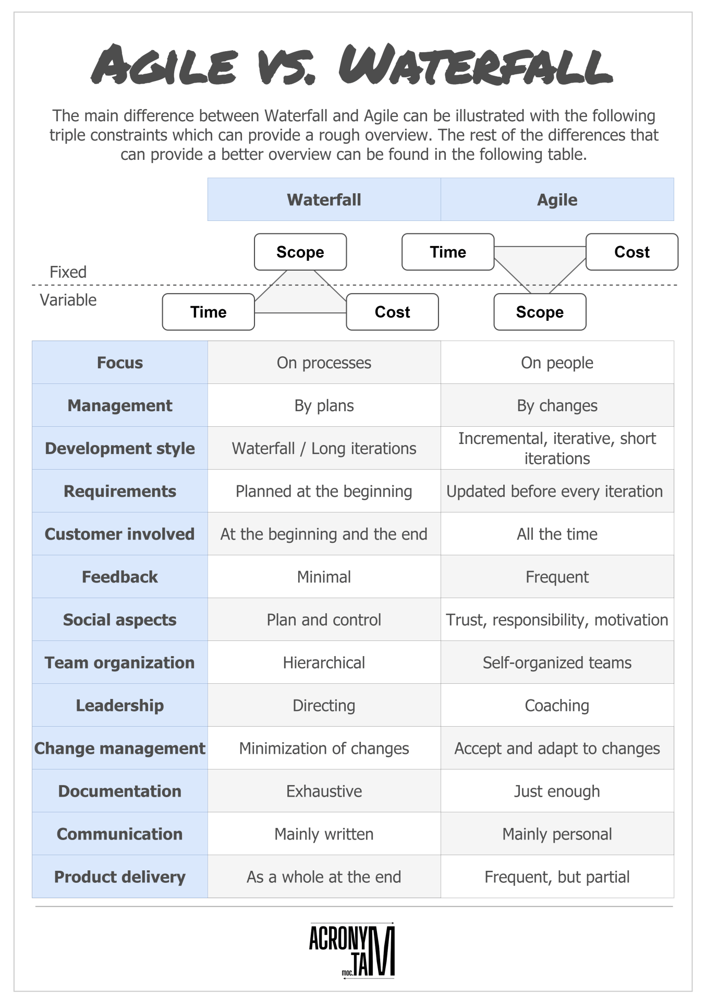

Slide 75
DevOps

Slide 76
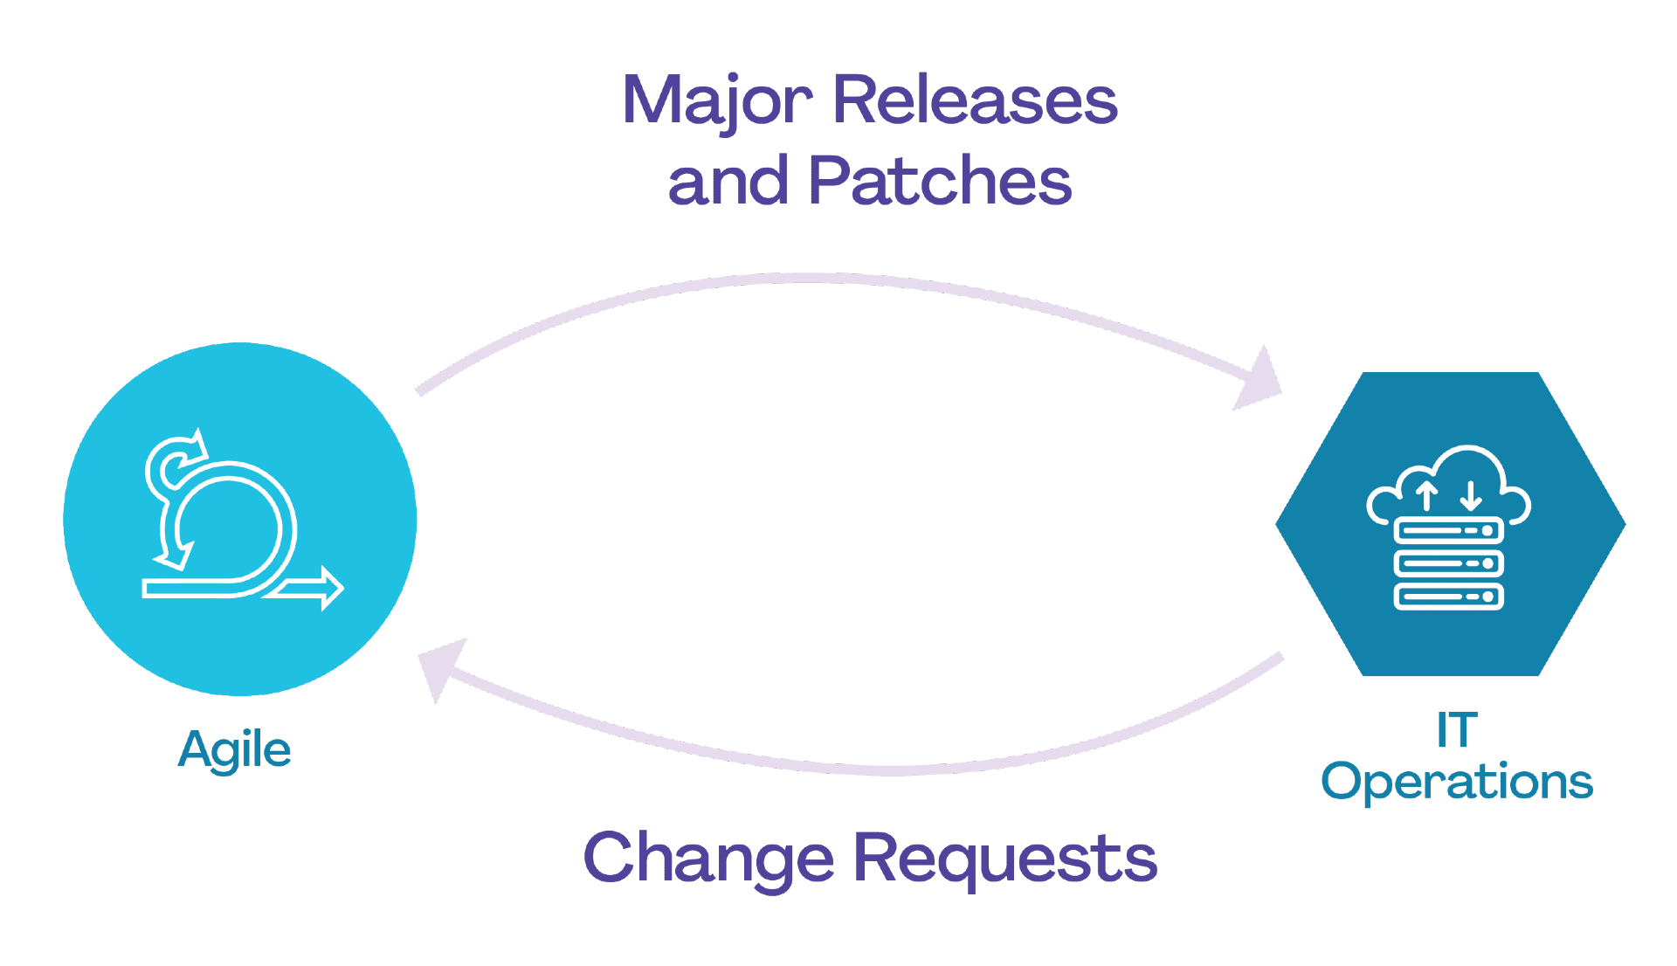
DevOps

Slide 77
DevOps
When organizations address these challenges by removing the barriers that inhibit effective collaboration, they close the DevOps gap.
Organizations do this by: adopting a mindset that promotes collaborative; learning-centric ways of working that are supported by agile practices; and very often investing significantly in automation
On the development side they tend to adopt a continuous delivery (CD) approach and their operations efforts become streamlined and more automated.

Slide 78
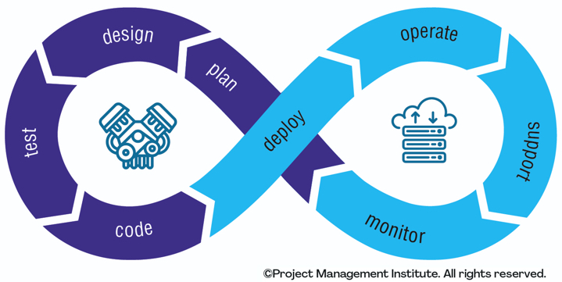
DevOps

Slide 79
DevOps
DevOps is an approach to software development that extends the principles of agile development by integrating both the development and operations units of the IT team into one homogenous unit.
This integration enables a more seamless flow between the traditionally siloed sides of the software development lifecycle and leads to fewer defects in production because operating requirements were considered from the outset of the project.

Slide 80
DevOps
According to a study, the global DevOps market size was $7,398 million in 2021, and it is anticipated to increase to $37,227 million by 2030, with a significant CAGR of 20% from 2022 to 2030.
With this being said, DevOps project management will remain essential to any significant commercial venture to complete the project on schedule and under budget.
It entails careful planning, resource allocation, and coordination between numerous stakeholders.

Slide 81
DevOps vs. Project Management
Given the fluid nature of DevOps and its continuous integration/continuous deployment (CI/CD) process, the methodology may seem at odds with project management strategies that tend to follow timelines with a set start and endpoint.
These approaches seem more closely aligned with traditional software delivery methods like the waterfall approach.
However, project management styles can adapt to fit the parameters of the DevOps pipeline.
The key is to shift the focus away from the one final product and instead refactor the timeline to follow the agile approach of incremental deliveries at the end of each sprint.

Slide 82
What is DevOps project management?
DevOps project management is a union between the two disciplines where project management is tailored to and supports the DevOps model.
In a DevOps project management approach, project managers serve as coordinators between multiple contributors and as trackers of timelines and dependencies.
However, project managers also need to be closely aligned with the DevOps team and bring a deep understanding of the development process and skills needed to create the end product.
There are several best practices that project managers should follow to achieve this integration with the DevOps pipeline.

Slide 83
DevOps Project Management Best Practices
Develop a collaborative culture.
Embrace the MVP mindset.
Focus on both on-time and quality deliveries.
Emphasize dependencies.
Use tools to do the heavy lifting.
Track the right metrics

Slide 84
DevOps Project Management Best Practices
Develop a collaborative culture.
Get leadership on board from the beginning
Implement the right tools and technologies
Align the right people for the team
Educate and train the team
Empower the team with a sense of autonomy and ownership
Establish a pattern of continuous improvement and learning
Inculcate a sense of shared responsibility
Prioritize open and transparent communication
Establish an environment of trust and respect
Share common goals and vision

Slide 85
DevOps Project Management Best Practices
Embrace the MVP mindset.
The minimum viable product (MVP) is the simplest version of an application that will still meet the central requirements of the project.
DevOps embraces the MVP as a philosophy to ensure there is always a deliverable at the end of each sprint without delaying turnaround with an overly wide scope.
In contrast to traditional project management strategies that emphasize the final monolithic product, this is a considerable shift. DevOps is viewed less as a linear process with set start and end dates and more as a constant process of improvement.
The advantages of the MVP mindset are that customers receive a deliverable faster and their feedback then helps the team course correct earlier in the cycle.

Slide 86
DevOps Project Management Best Practices
Focus on both on-time and quality deliveries.
Project management places a heavy emphasis on meeting deadlines. While this is important, many of the metrics DevOps teams use to measure success focus on more qualitative factors to gauge if the customer is meeting their goals with the application.
This means that quick turnaround times are important. So is allocating enough time and resources to ensure the deliverable quality meets a high standard. Project managers need to weigh both these factors when deciding on the goals for a sprint and assigning tasks.
Part of an effective delegation of responsibilities is understanding the dependencies for each task.

Slide 87
DevOps Project Management Best Practices
Emphasize dependencies.
Even in system architecture that follows a microservice approach of building small applications to handle individual tasks, there are dependencies between these applications, the systems they run on, the data they handle, and more.
Tracking dependencies goes beyond configuration management. It requires maintaining visibility into all the moving parts of both the IT environment and the DevOps team's tasks to properly define sprint goals.
Each deliverable should fully function in the existing environment and be ready to deploy at the end of each DevOps cycle. If that delivery is slowed by a backlog of tasks or a system requirement not being met, then more thorough dependency tracking is needed.

Slide 88
DevOps Project Management Best Practices
Use tools to do the heavy lifting.
Automation is a major focus in DevOps to scale the impact of a team's effort, and DevOps project management is no different.
Project management tools provide a single source of truth for how work has been assigned, how the project is proceeding, and what issues have occurred along the way. This information is valuable for the entire team to provide greater context and foster more informed decision-making.
These applications will overlap with the tools the DevOps team uses in their day-to-day work so that both project managers and developers are on the same page.
Dashboards can provide real-time metrics on how the team is performing against their goals and help project managers detect potential issues to address earlier in the cycle.

Slide 89
DevOps Project Management Best Practices
Track the right metrics.
DevOps best practices recommend constant performance tracking.
You can use project management tools with built-in analytics reports to give you insight into data and performance tracking capabilities.
Tracking the right performance indicators, such as lead time, mean time to detect, and issue severity to assess the efficacy of a DevOps approach. Tracking these indicators is essential since it enables you to identify problems early and take swift corrective action.
The goals and standards of your enterprise will determine the DevOps metrics you need to monitor. Any engineering and development team can benefit from some indicators connected to profitability, like unit cost.

Slide 90
DevOps project management leads to better outcomes.
By combining the practice of DevOps with the principles of project management, you achieve greater coordination between individual team members and the larger goals of the sprint.
This leads to better outcomes by ensuring that task scopes are properly defined and dependencies are tracked so the application is ready to deploy.
DevOps project management tools simplify this process and promote visibility between project managers and team members so everyone is on the same page and working toward the same goals.

Slide 91
What is the Role of a DevOps Project Manager?
Project managers’ roles have evolved due to Scrum and other agile approaches.
Project managers in a DevOps project management methodology liaise between various contributors and keep track of deadlines and commitments.
They also need to have a strong awareness of the development process and the abilities required to produce the final product and work closely with the DevOps team.
DevOps project managers have the responsibility to address the management and coordination of the product from development to production. They mainly work on technical details, whereas a traditional project manager is not involved in handling these tasks.
DevOps project managers ensure they manage the integration, flow of development, testing, coordination, and deployment of the project.

Slide 92
What is the Role of a DevOps Project Manager?
Treat the development and operations team as a single organization
Effectively embrace change

Slide 93
What is the Role of a DevOps Project Manager?
Treat the development and operations team as a single organization
DevOps requires a leader who can assist the team in seeing the flow from beginning to end, much like a typical project manager’s role is to plan, acquire, and execute the project.

Slide 94
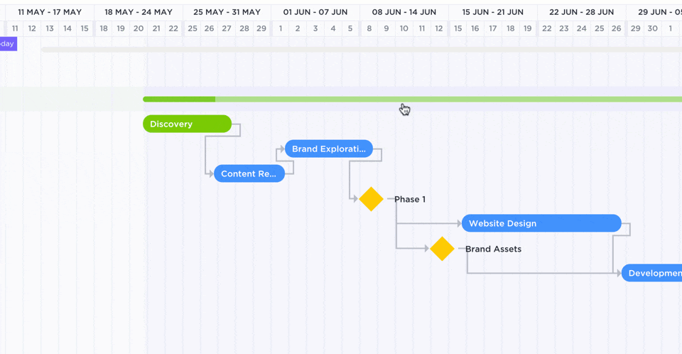
What is the Role of a DevOps Project Manager?
Treat the development and operations team as a single organization
Creating value stream maps should be a natural extension of the project manager’s Gantt Chart planning abilities.

Slide 95
What is the Role of a DevOps Project Manager?
Treat the development and operations team as a single organization
Treating the Development and Operations team as a single organization is important to prevent work silos.
These two teams are merged into a single team to work across the entire application lifecycle and develop various skills, from development and testing to deployment to operations.
Attempts to use DevOps will be unsuccessful unless Dev and Ops teams collaborate more effectively.
The development and operations teams have several impacts on task handling: educating and sharing responsibilities between Devs and Ops teams, improving productivity and collaboration, understanding deployment risks, awareness of tool quality, and managing added tasks.

Slide 96
What is the Role of a DevOps Project Manager?
Effectively embrace change
The agile project management methodology clarifies that embracing change rather than sticking to the plan is crucial.
It takes a lot of communication and teamwork to manage change and release features incrementally. Communication is a project manager’s primary skill. Enterprises ought to make use of this potential.

Slide 97
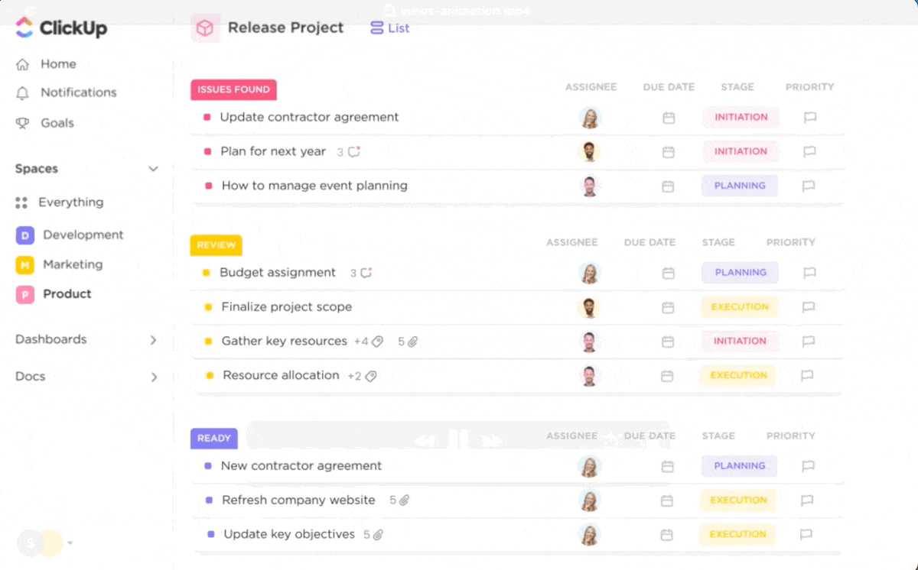
What is the Role of a DevOps Project Manager?
Effectively embrace change
For example, DevOps project managers need to embrace a few changes for their professional growth, such as starting to work on small projects:
using the MVP approach,
using the right agile planning tools,
eliminating silos,
reducing project handoffs,
creating real-time project visibility,
reducing project overhead, and
managing change collaboratively.

Slide 98
5 Best Practices for DevOps Project Management
Effectively embrace change
The agile project management methodology clarifies that embracing change rather than sticking to the plan is crucial.
It takes a lot of communication and teamwork to manage change and release features incrementally. Communication is a project manager’s primary skill. Enterprises ought to make use of this potential.

